Slide 1
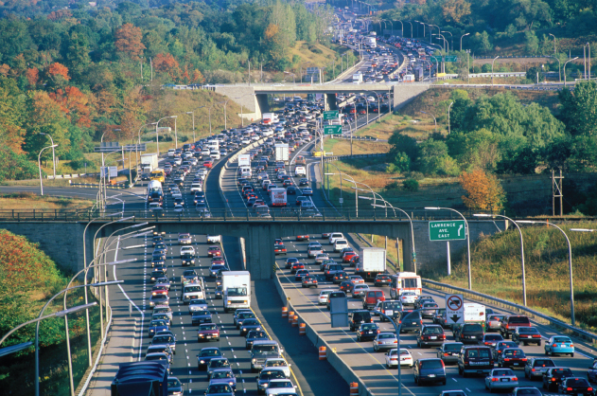
5
EFFICIENCY
AND EQUITY

Slide 2
After studying this chapter you will be able to
Describe the alternative methods of allocating scarce resources
Explain the connection between demand and marginal benefit and define consumer surplus; and ...
explain the connection between supply and marginal cost and define producer surplus
Explain the conditions under which markets are efficient and inefficient
Explain the main ideas about fairness and evaluate claims that markets result in unfair outcomes
Copyright © 2013 Pearson Canada Inc., Toronto, Ontario

Slide 3
Every time you order a pizza or buy a Valentine’s Day rose, you express your view about how scarce resources should be used.
You make choices in your self-interest.
Markets coordinate your choices along with those of everyone else.
But do markets do a good job?
Do they enable our self-interest choices to be in the social interest?
Do markets produce a fair outcome?
Copyright © 2013 Pearson Canada Inc., Toronto, Ontario

Slide 4
Resource Allocation Methods
  Scare resources might be allocated by
    Market price
    Command
    Majority rule
    Contest
    First-come, first-served
    Lottery
    Personal characteristics
    Force
  How does each method work?

Slide 5
Resource Allocation Methods
Market Price
  When a market allocates a scarce resource, the people who get the resource are those who are willing to pay the market price.
  Most of the scarce resources that you supply get allocated by market price.
  You sell your labour services in a market, and you buy most of what you consume in markets.
  For most goods and services, the market turns out to do a good job.

Slide 6
Resource Allocation Methods
Command
  Command system allocates resources by the order (command) of someone in authority.
  For example, if you have a job, most likely someone tells you what to do. Your labor time is allocated to specific tasks by command.
  A command system works well in organizations with clear lines of authority but badly in an entire economy.

Slide 7
Resource Allocation Methods
Majority Rule
  Majority rule allocates resources in the way the majority of voters choose.
  Societies use majority rule for some of their biggest decisions.
  For example, tax rates that allocate resources between private and public use and tax dollars between competing uses such as defense and health care.
  Majority rule works well when the decision affects lots of people and self-interest must be suppressed to use resources efficiently.

Slide 8
Resource Allocation Methods
Contest
  A contest allocates resources to a winner (or group of winners).
  The most obvious contests are sporting events but they occur in other arenas:
  For example: The Oscars are a type of contest. So is the CEO the winner of a contest.
  Contest works well when the efforts of the “players” are hard to monitor and reward directly.

Slide 9
Resource Allocation Methods
First-Come, First-Served
  A first-come, first-served allocates resources to those who are first in line.
  Casual restaurants use first-come, first served to allocate tables. Supermarkets also uses first-come, first-served at checkout.
  First-come, first-served works best when scarce resources can serve just one person at a time in a sequence.

Slide 10
Resource Allocation Methods
Lottery
  Lotteries allocate resources to those with the winning number, draw the lucky cards, or come up lucky on some other gaming system.
  State lotteries and casinos reallocate millions of dollars worth of goods and services each year.
  But lotteries are more widespread. For example, they are used to allocate landing slots at some airports.
  Lotteries work well when there is no effective way to distinguish among potential users of a scarce resource.

Slide 11
Resource Allocation Methods
Personal Characteristics
  Personal characteristics allocate resources to those with the “right” characteristics.
  For example, people choose marriage partners on the basis of personal characteristics.
  But this method gets used in unacceptable ways: allocating the best jobs to white males and discriminating against minorities and women.

Slide 12
Resource Allocation Methods
Force
  Force plays a role in allocating resources.
  For example, war has played an enormous role historically in allocating resources.
  Theft, taking property of others without their consent, also plays a large role.
  But force provides an effective way of allocating resources—for the state to transfer wealth from the rich to the poor and establish the legal framework in which voluntary exchange can take place in markets.

Slide 13
Benefit, Cost, and Surplus
Demand, Willingness to Pay, and Value
  Value is what we get, price is what we pay.
  The value of one more unit of a good or service is its marginal benefit.
  We measure value as the maximum price that a person is willing to pay.
  But willingness to pay determines demand.
  A demand curve is a marginal benefit curve.

Slide 14
Benefit, Cost, and Surplus
Individual Demand and Market Demand
The relationship between the price of a good and the quantity demanded by one person is called individual demand.
The relationship between the price of a good and the quantity demanded by all buyers in the market is called market demand.
Figure 5.1 on the next slide shows the connection between individual demand and market demand.

Slide 15
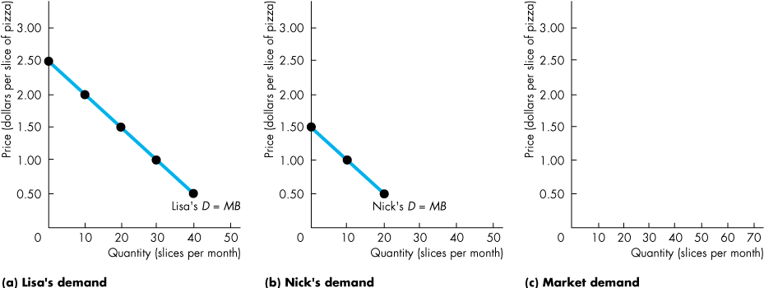
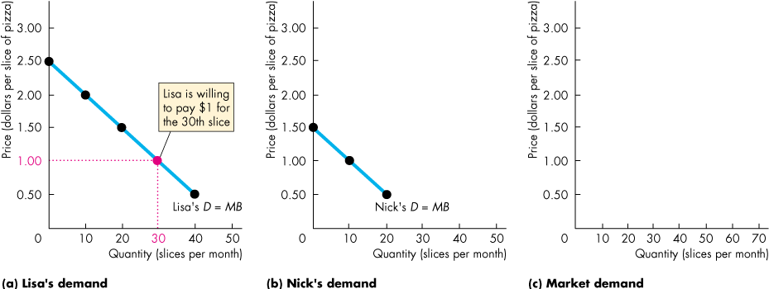
Benefit, Cost, and Surplus
Lisa and Nick are the only buyers in the market for pizza.
At $1 a slice, the quantity demanded by Lisa is 30 slices.

Slide 16
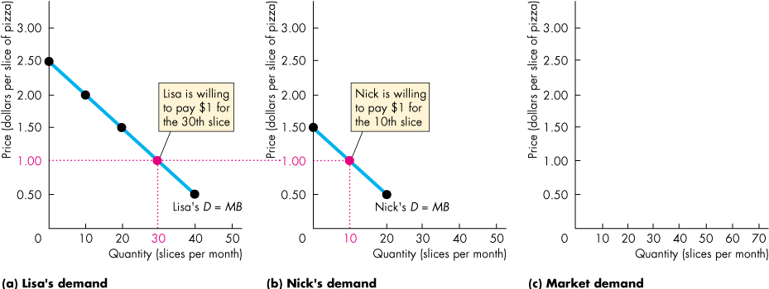
Benefit, Cost, and Surplus
Lisa and Nick are the only buyers in the market for pizza.
At $1 a slice, the quantity demanded by Nick is 10 slices.

Slide 17
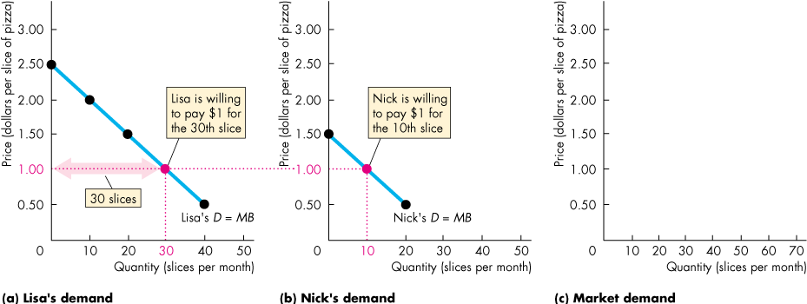
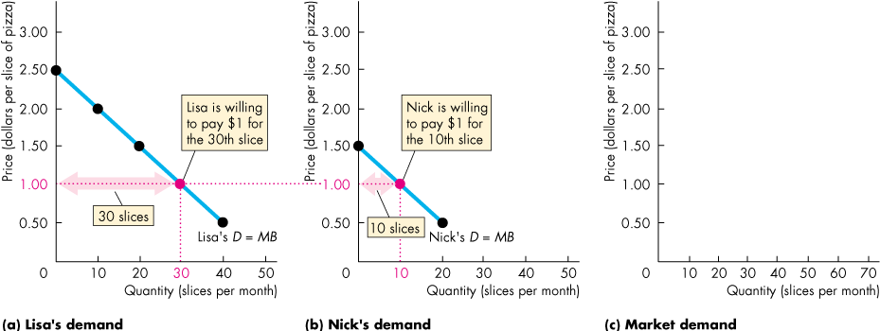
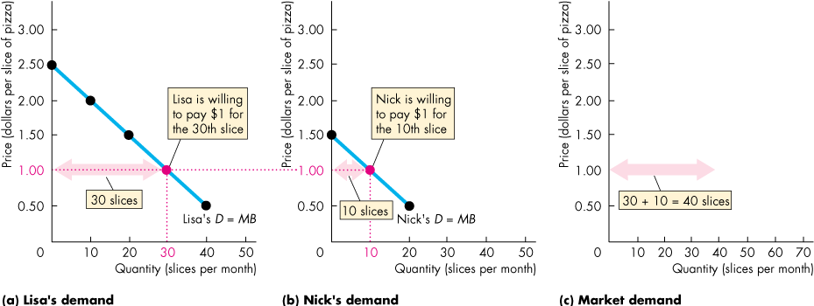
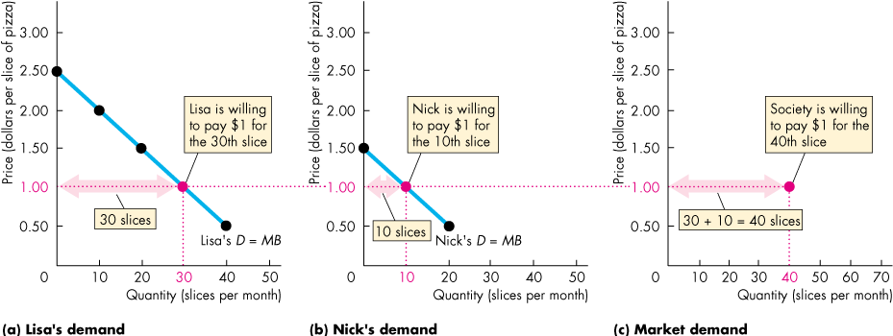
Benefit, Cost, and Surplus
At $1 a slice, the quantity demanded by Lisa is 30 slices and by Nick is 10 slices.
The quantity demanded by all buyers in the market is 40 slices.

Slide 18
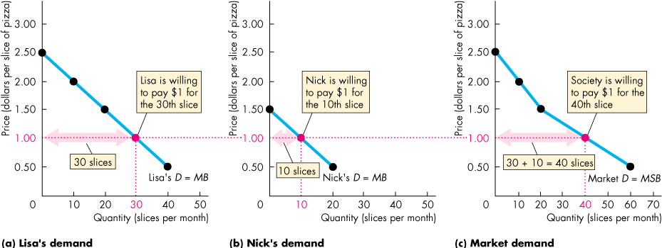
Benefit, Cost, and Surplus
The market demand curve is the horizontal sum of the individual demand curves.

Slide 19
Benefit, Cost, and Surplus
Consumer Surplus
  Consumer surplus is the excess of the benefit received from a good over the amount paid for it.
  We can calculate consumer surplus as the marginal benefit (or value) of a good minus its price, summed over the quantity bought.
  It is measured by the area under the demand curve and above the price paid, up to the quantity bought.
  Figure 5.2 on the next slide shows the consumer surplus from pizza when the market price is $1 a slice.

Slide 20
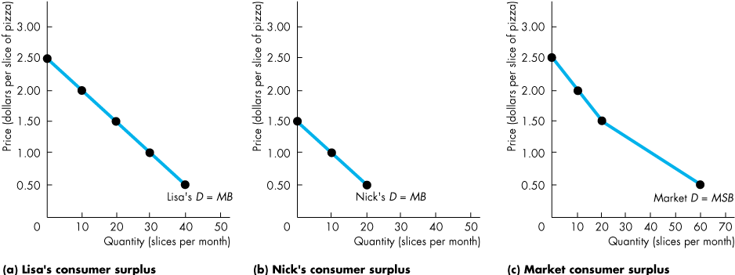
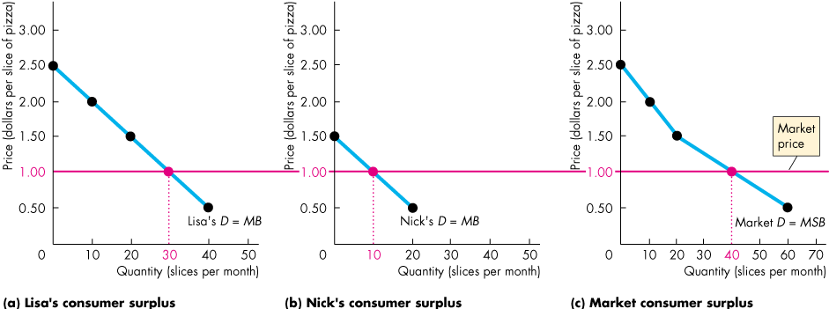
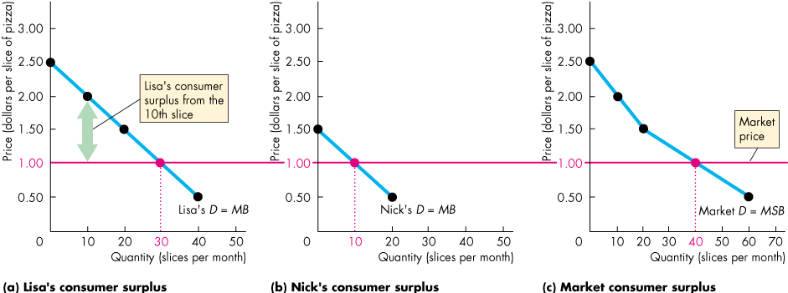
Benefit, Cost, and Surplus
  Lisa and Nick pay the market price, which is $1 a slice.
  The value Lisa places on the 10th slice is $2.
  Lisa’s consumer surplus from the 10th slice is the value minus the price, which is $1.

Slide 21
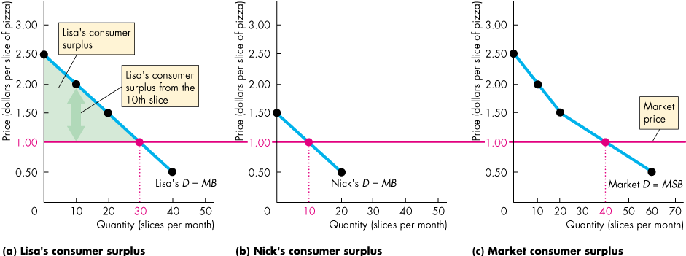
Benefit, Cost, and Surplus
  At $1 a slice, Lisa buys 30 slices.
  So her consumer surplus is the area of the green triangle.

Slide 22
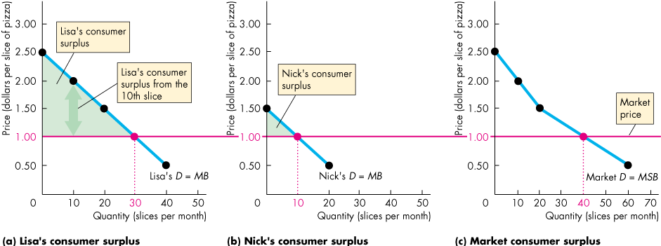
Benefit, Cost, and Surplus
  At $1 a slice, Nick buys 10 slices.
  So his consumer surplus is the area of the green triangle.

Slide 23
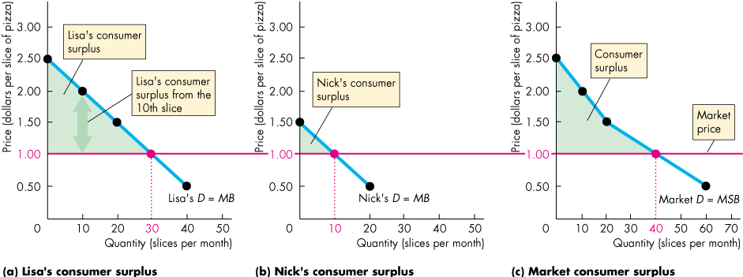
Benefit, Cost, and Surplus
  At $1 a slice, the consumer surplus for the economy is the area under the market demand curve above the market price, summed over the 40 slices bought.

Slide 24
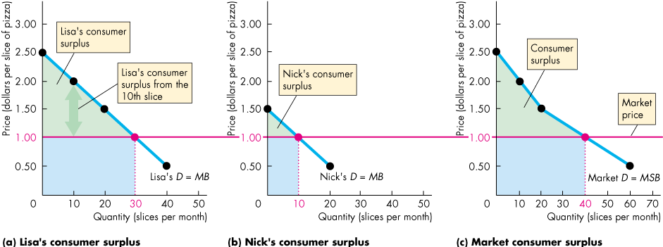
Benefit, Cost, and Surplus
  At $1 a slice, Lisa spends $30, Nick spends $10, and together they spend $40 on pizza.
  The consumer surplus is the value from pizza in excess of the expenditure on it.

Slide 25
Benefit, Cost, and Surplus
Supply and Marginal Cost
Firms are in business to make a profit.
To make a profit, firms must sell their output for a price that exceeds the cost of production.
Firms distinguish between cost and price.

Slide 26
Benefit, Cost, and Surplus
Supply, Cost, and Minimum Supply-Price
Cost is what the producer gives up, price is what the producer receives.
The cost of one more unit of a good or service is its marginal cost.
Marginal cost is the minimum price that a firm is willing to accept.
But the minimum supply-price determines supply.
A supply curve is a marginal cost curve.

Slide 27
Benefit, Cost, and Surplus
Individual Supply and Market Supply
The relationship between the price of a good and the quantity supplied by one producer is called individual supply.
The relationship between the price of a good and the quantity supplied by all producers in the market is called market supply.
Figure 5.3 on the next slide shows the connection between individual supply and market supply.

Slide 28
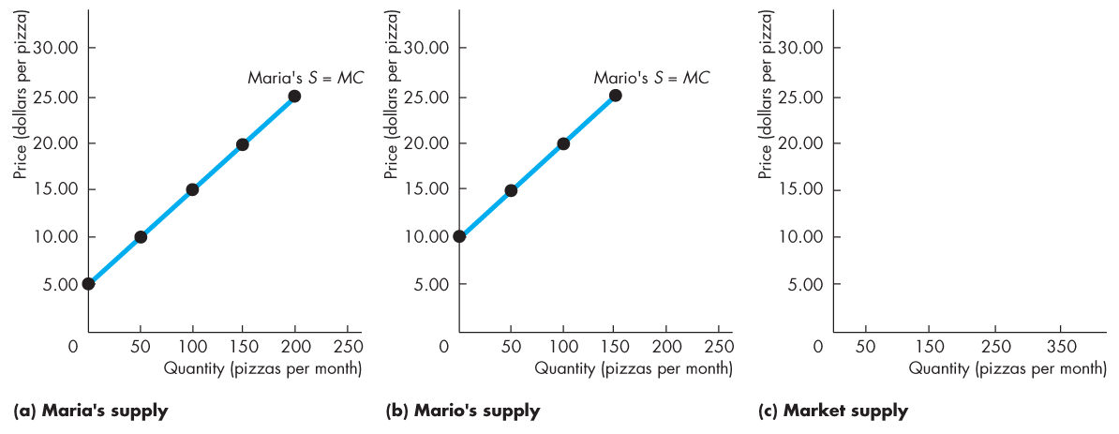
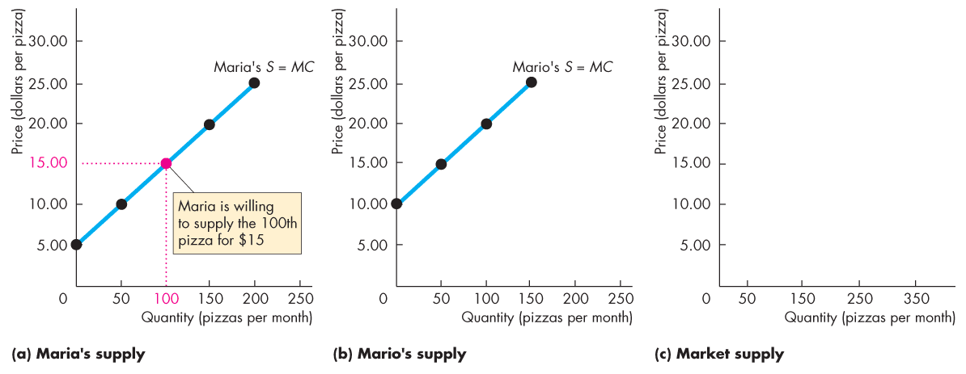
Benefit, Cost, and Surplus
Maria and Mario are the only producers of pizza.
At $15 a pizza, the quantity supplied by Maria is 100 pizzas.

Slide 29
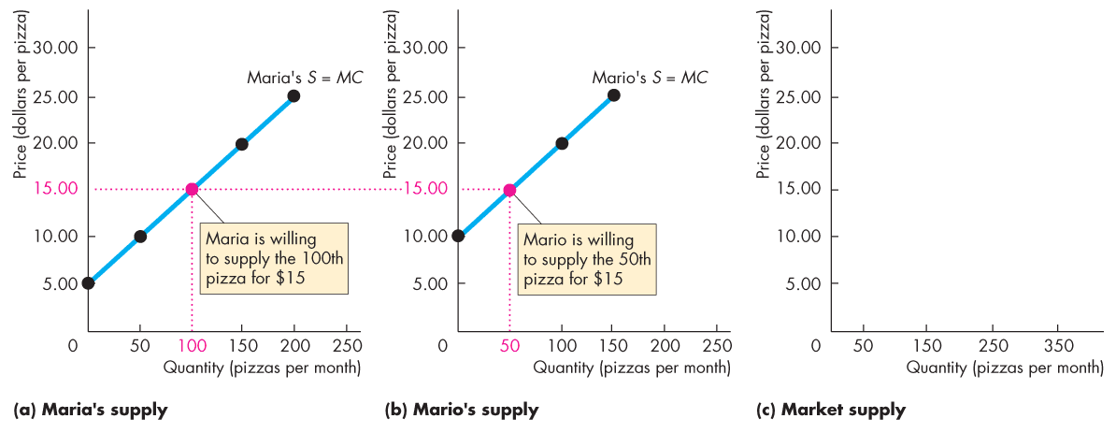
Benefit, Cost, and Surplus
Maria and Mario are the only producers of pizza.
At $15 a pizza, the quantity supplied by Mario is 50 pizzas.

Slide 30
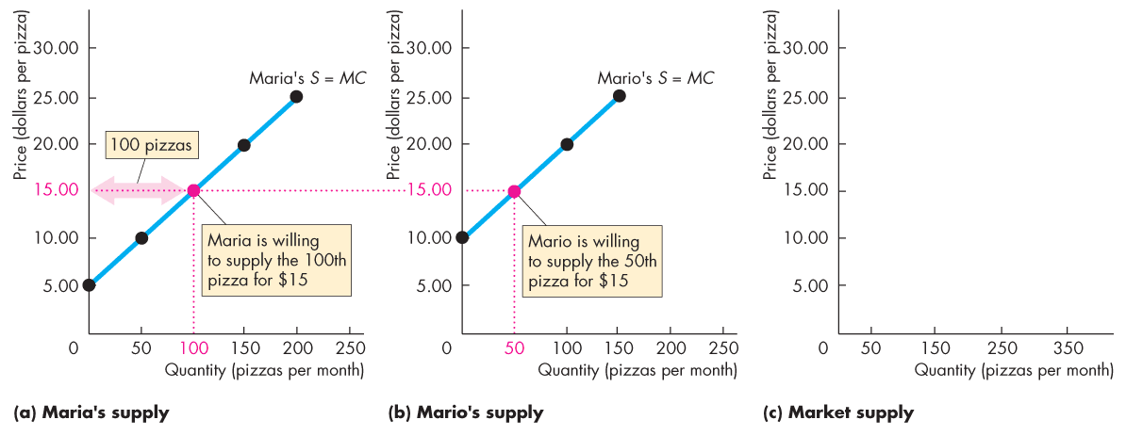
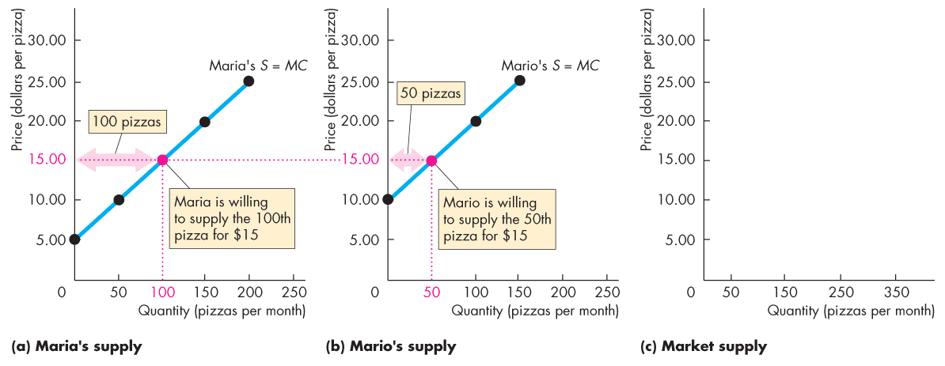
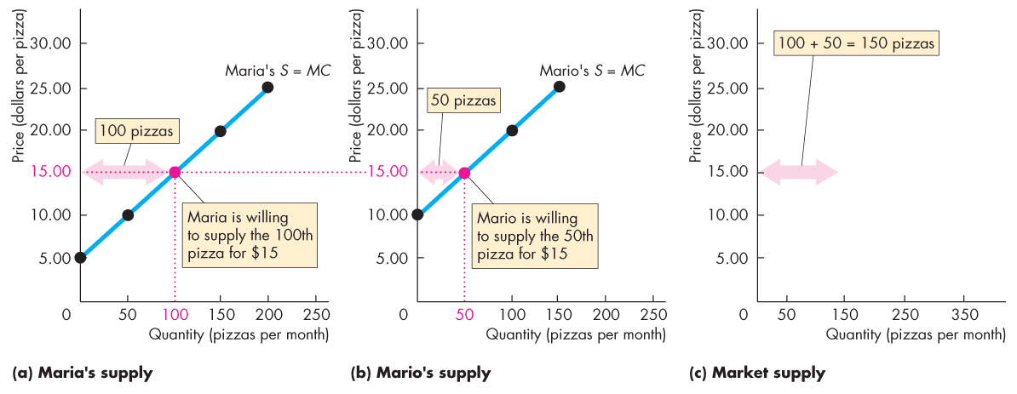
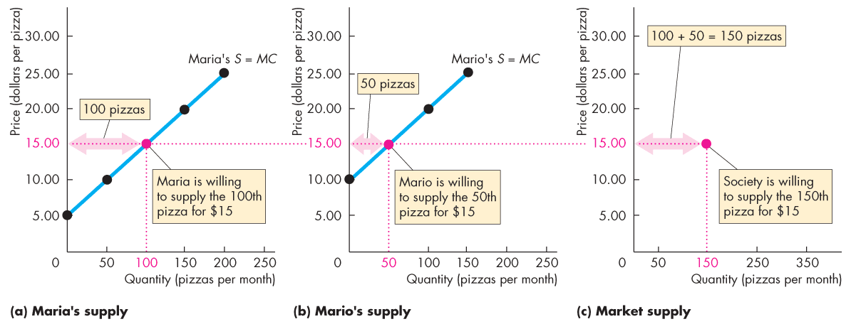
Benefit, Cost, and Surplus
At $15 a pizza, the quantity supplied by Maria is 100 pizzas and by Mario is 50 pizzas.
The quantity supplied by all producers is 150 pizzas.

Slide 31
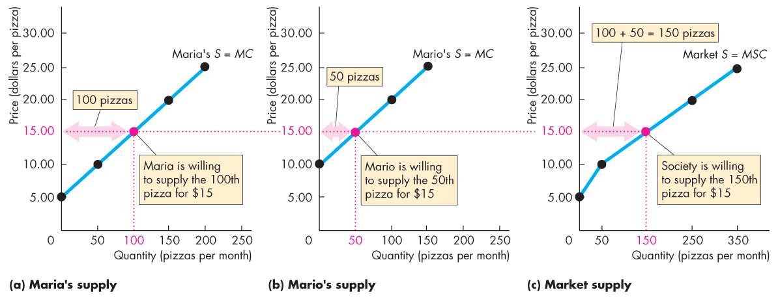
Benefit, Cost, and Surplus
The market supply curve is the horizontal sum of the individual supply curves.

Slide 32
Benefit, Cost, and Surplus
Producer Surplus
  Producer surplus is the excess of the amount received from the sale of a good over the cost of producing it.
  We calculate it as the price received for a good minus the minimum-supply price (marginal cost), summed over the quantity sold.
  On a graph, producer surplus is shown by the area below the market price and above the supply curve, summed over the quantity sold.
  Figure 5.4 on the next slide shows the producer surplus from pizza when the market price is $15 a pizza.

Slide 33
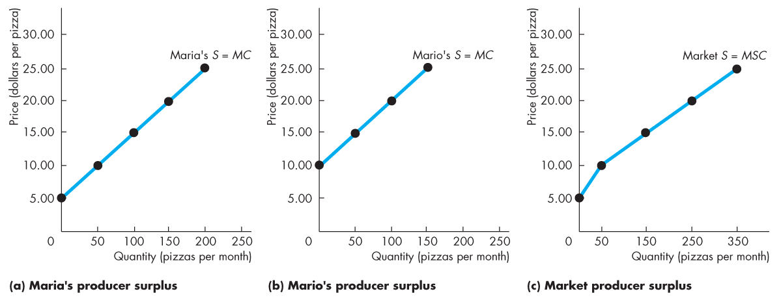
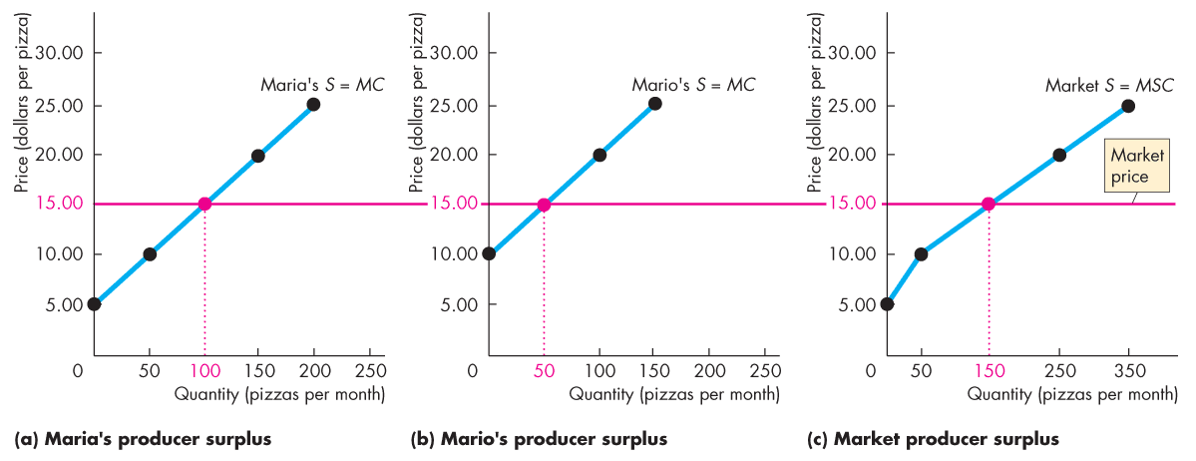
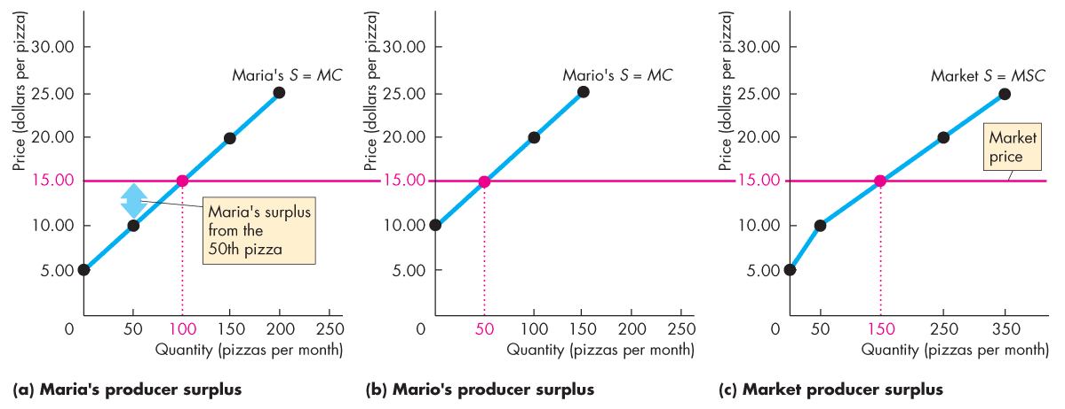
Benefit, Cost, and Surplus
  Maria is willing to produce the 50th pizza for $10.
  Maria’s surplus from the 50th pizza is the price minus the marginal cost, which is $5.

Slide 34
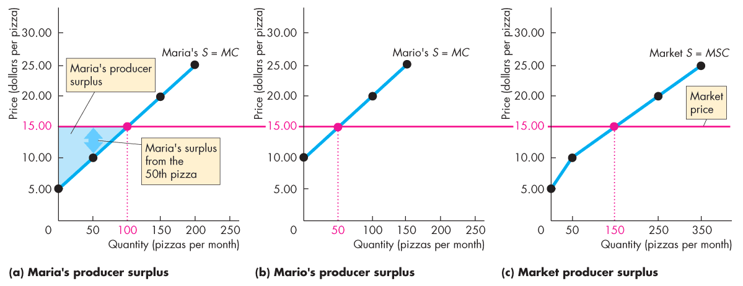
Benefit, Cost, and Surplus
  At $15 a pizza, Maria sells 100 pizzas.
  So her producer surplus is the area of the blue triangle.

Slide 35
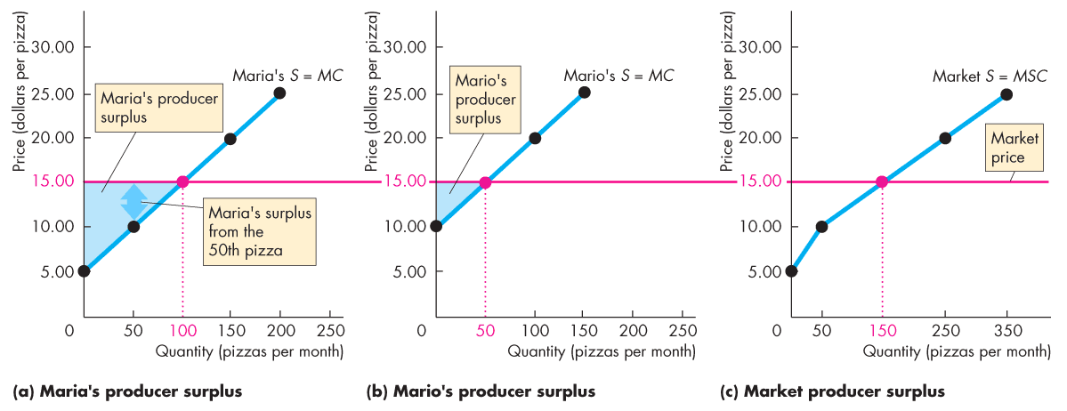
Benefit, Cost, and Surplus
  At $15 a pizza, Mario sells 50 pizzas.
  So his producer surplus is the area of the blue triangle.

Slide 36
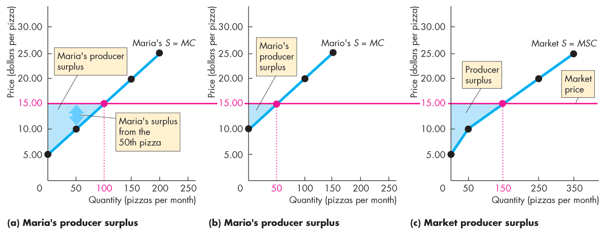
Benefit, Cost, and Surplus
  At $15 a pizza, the producer surplus for the economy is the area under the market price above the market supply curve, summed over the 150 pizzas sold.

Slide 37
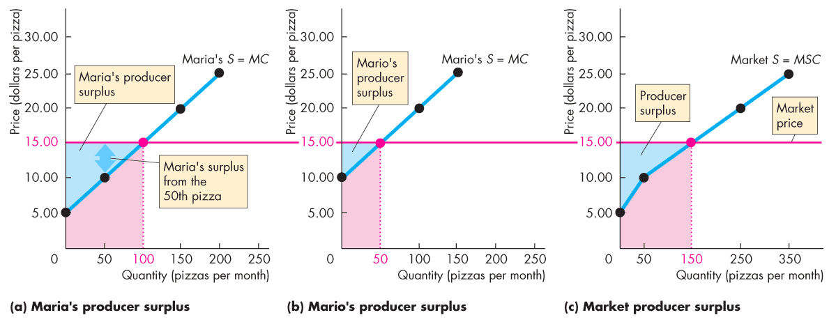
Benefit, Cost, and Surplus
  The red areas show the cost of producing the pizzas sold.
  The producer surplus is the value of the pizza sold in excess of the cost of producing it.

Slide 38
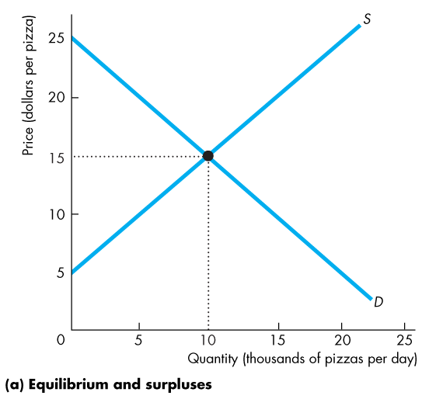
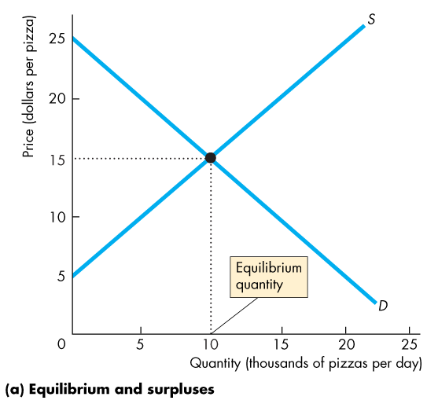
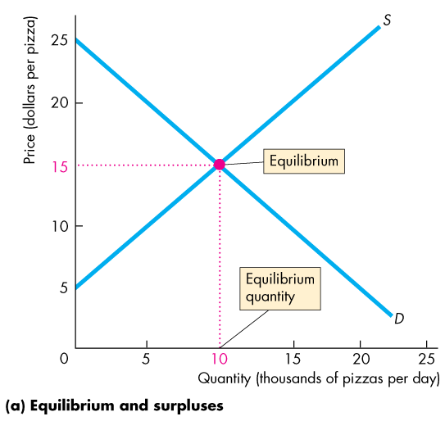
Is the Competitive Market Efficient?
Efficiency of Competitive Equilibrium
  Figure 5.5 shows that a competitive market creates an efficient allocation of resources at equilibrium.
  In equilibrium, the quantity demanded equals the quantity supplied.
Copyright © 2013 Pearson Canada Inc., Toronto, Ontario

Slide 39
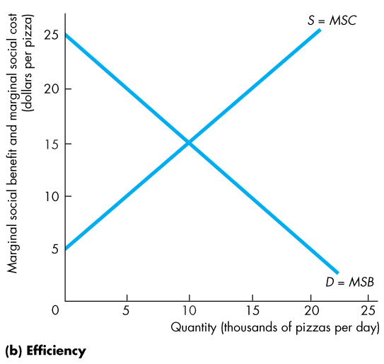
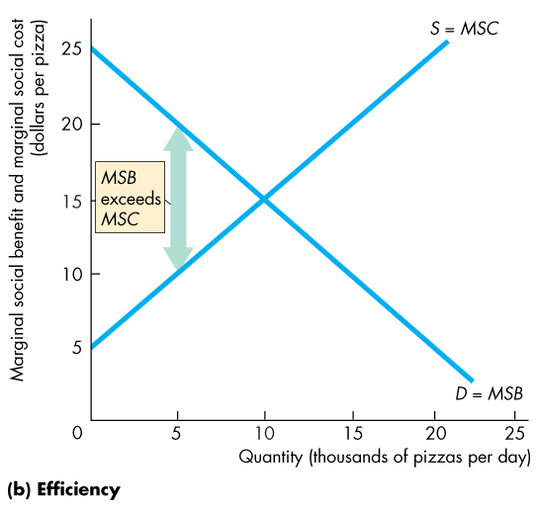
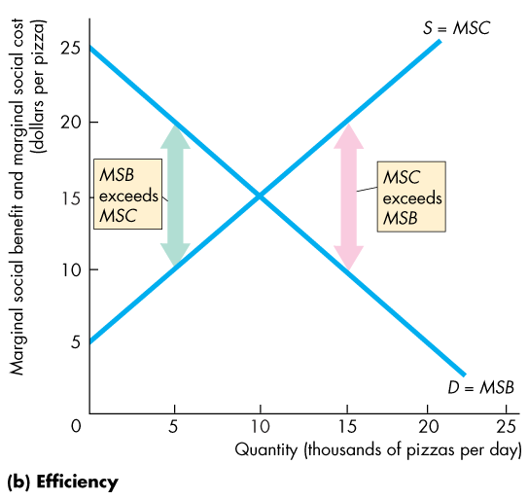
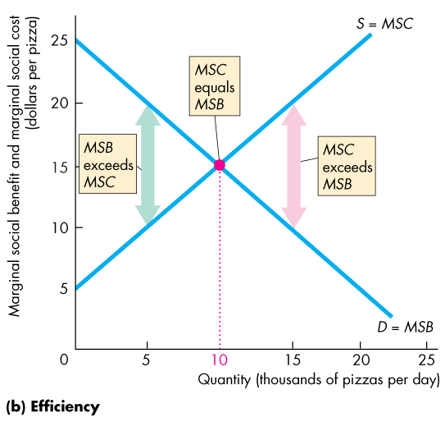
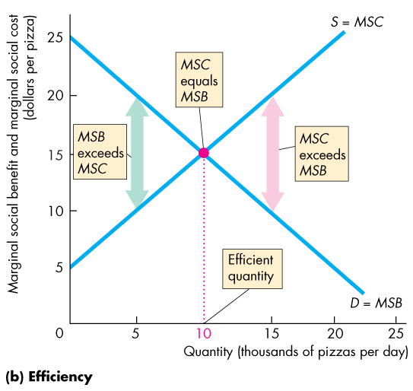
Is the Competitive Market Efficient?
  When production is:
  less than the equilibrium quantity, MSB > MSC.
  greater than the equilibrium quantity,
  MSC > MSB.
  equal to the equilibrium quantity, MSC = MSB.

Slide 40
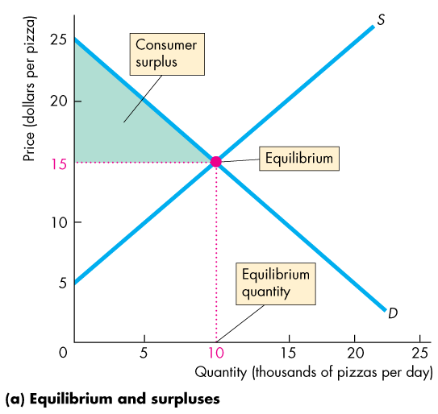
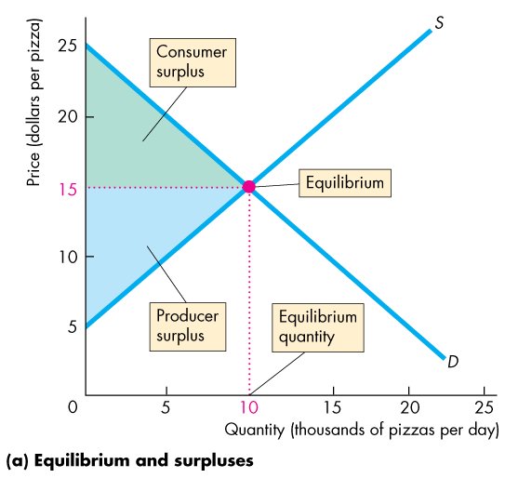
Is the Competitive Market Efficient?
  Resources are used efficiently when marginal social benefit equals marginal social cost.
  When the efficient quantity is produced, total surplus (the sum of consumer surplus and producer surplus) is maximized.
Copyright © 2013 Pearson Canada Inc., Toronto, Ontario

Slide 41
Is the Competitive Market Efficient?
The Invisible Hand
  Adam Smith’s “invisible hand” idea in the Wealth of Nations implied that competitive markets send resources to their highest valued use in society.
  Consumers and producers pursue their own self-interest and interact in markets.
  Market transactions generate an efficient—highest valued—use of resources.

Slide 42
Is the Competitive Market Efficient?
Market Failure
  Markets don’t always achieve an efficient outcome.
  Market failure arises when a market delivers an inefficient outcome.
  Market failure can occur because
  Too little of an item is produced (underproduction) or
  Too much of an item is produced (overproduction).

Slide 43
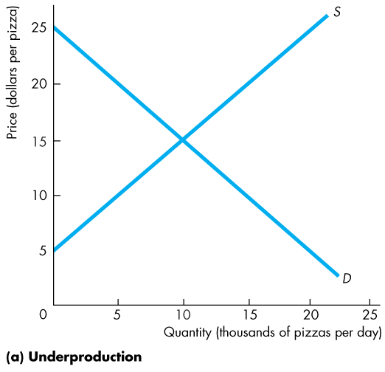
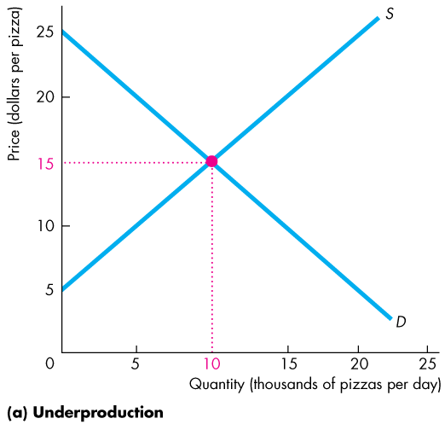
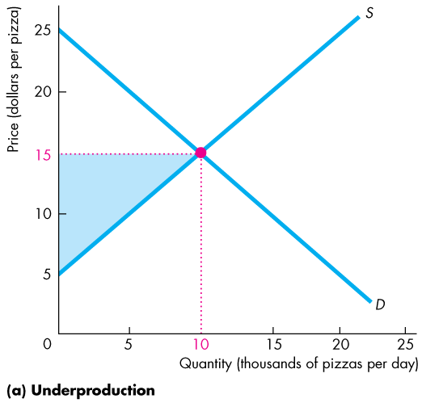
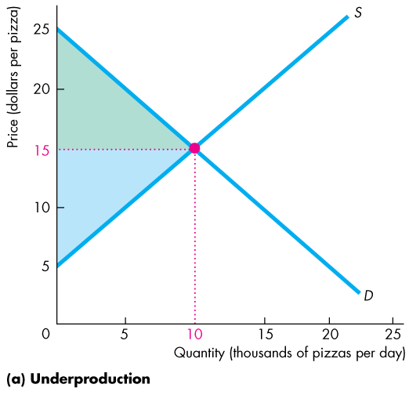

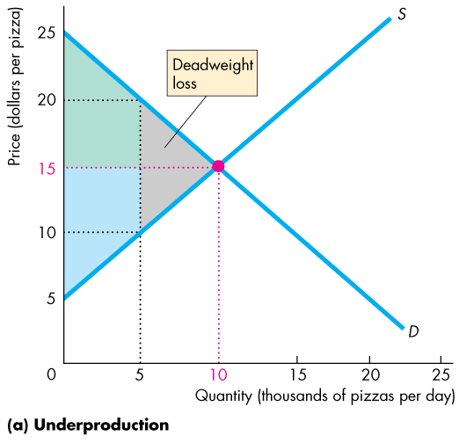
Is the Competitive Market Efficient?
  Underproduction
  The efficient quantity is 10,000 pizzas a day.
  If production is restricted to 5,000 pizzas a day, there is underproduction and the quantity is inefficient.
  A deadweight loss equals the decrease in total surplus—the grey triangle.
  This loss is a social loss.
Copyright © 2013 Pearson Canada Inc., Toronto, Ontario

Slide 44
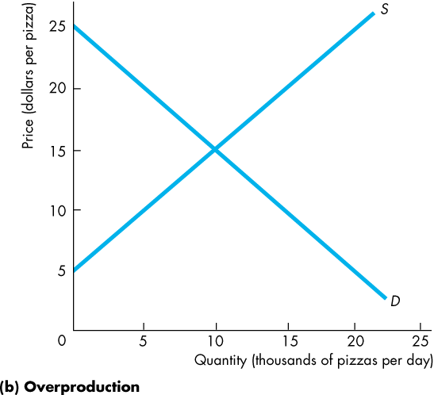
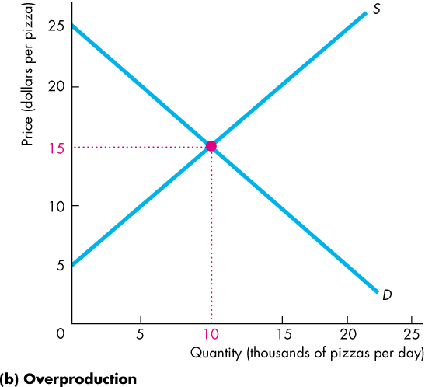
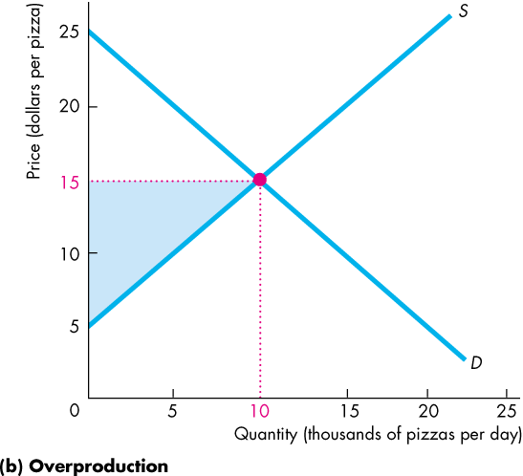
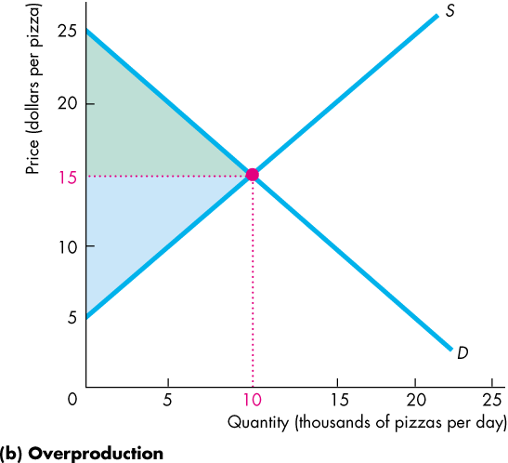


Is the Competitive Market Efficient?
  Overproduction
  Again, the efficient quantity is 10,000 pizzas a day.
  If production is expanded to 15,000 pizzas a day, a deadweight loss arises from overproduction.
  This loss is a social loss.
Copyright © 2013 Pearson Canada Inc., Toronto, Ontario

Slide 45
Is the Competitive Market Efficient?
  Sources of Market Failure
  In competitive markets, underproduction or overproduction arise when there are
    Price and quantity regulations (Chapter 6)
    Taxes and subsidies (Chapter 6)
    Monopoly (Chapter 13)
    Externalities (Chapter 16)
    Public goods (Chapter 17)

Slide 46
Is the Competitive Market Efficient?
  Price and Quantity Regulations
  Price regulations, such as minimum wage laws and rent controls, sometimes block price adjustments and lead to underproduction.
  Quantity regulations, such as agricultural production quotas and hunting and fishing licenses, that limit the quantity of a good that may be produced also leads to underproduction.

Slide 47
Is the Competitive Market Efficient?
  Taxes and Subsidies
  Taxes increase the prices paid by buyers and lower the prices received by sellers.
  So taxes decrease the quantity produced and lead to underproduction.
  Subsidies lower the prices paid by buyers and increase the prices received by sellers.
  So subsidies increase the quantity produced and lead to overproduction.

Slide 48
Is the Competitive Market Efficient?
  Monopoly
  A monopoly is a firm that has sole provider of a good or service.
  The self-interest of a monopoly is to maximize its profit. To do so, a monopoly sets a price to achieve its self-interested goal.
  As a result, a monopoly produces too little and underproduction results.

Slide 49
Is the Competitive Market Efficient?
  Externalities
  An externality is a cost or benefit that affects someone other than the seller or the buyer of a good.
  An electric utility creates an external cost by burning coal that creates pollution and acid rain.
  The utility doesn’t consider this cost when it chooses the quantity of power to produce. Overproduction results.

Slide 50
Is the Competitive Market Efficient?
  An apartment owner would provide an external benefit if she installed a smoke detector. But she doesn’t consider her neighbor’s marginal benefit and decides not to install the smoke detector.
  The result is underproduction.

Slide 51
Is the Competitive Market Efficient?
  Public Goods
  A public good benefits everyone and no one can be excluded from its benefits.
  It is in everyone’s self-interest to avoid paying for a public good (called the free-rider problem), which leads to underproduction.

Slide 52
Is the Competitive Market Efficient?
  Alternatives to the Market
  When a market is inefficient, can one of the non-market methods of allocation do a better job? Sometimes it can.
  Often, majority rule might be used to improve the allocation of resources.
  But majority rule has its own shortcomings. A group that pursues the self-interest of its members can become the majority.
  Also, with majority rule, votes must be translated into actions by bureaucrats who have their own agendas.
Copyright © 2013 Pearson Canada Inc., Toronto, Ontario

Slide 53
Is the Competitive Market Efficient?
  There is no one efficient mechanism for allocating resources efficiently.
  But markets, when supplemented by other mechanisms, do an amazingly good job.
Copyright © 2013 Pearson Canada Inc., Toronto, Ontario
Notes:
See correcting market failure from externalities, public goods and common resources, and monopoly and other non-competitive markets in Chapters 13-17.

Slide 54
Is the Competitive Market Fair?
  Ideas about fairness can be divided into two groups:
  It’s not fair if the result isn’t fair.
  It’s not fair if the rules aren’t fair.

Slide 55
Is the Competitive Market Fair?
It’s Not Fair if the Result Isn’t Fair
  The idea that only equality brings efficiency is called utilitarianism.
  Utilitarianism is the principle that states that we should strive to achieve “the greatest happiness for the greatest number.”

Slide 56
Is the Competitive Market Fair?
  If everyone gets the same marginal utility from a given amount of income, and
  if the marginal benefit of income decreases as income increases,
  then taking a dollar from a richer person and giving it to a poorer person increases the total benefit.
  Only when income is equally distributed has the greatest happiness been achieved.

Slide 57




Is the Competitive Market Fair?
  Figure 5.7 shows how redistribution increases efficiency.
  Tom is poor and has a high marginal benefit of income.
  Jerry is rich and has a low marginal benefit of income.
  Taking dollars from Jerry and giving them to Tom until they have equal incomes increases total benefit.
Copyright © 2013 Pearson Canada Inc., Toronto, Ontario

Slide 58
Is the Competitive Market Fair?
  The Big Tradeoff
  Utilitarianism ignores the cost of making income transfers.
  Recognizing these costs leads to the big tradeoff between efficiency and fairness.

Slide 59
Is the Competitive Market Fair?
It’s Not Fair If the Rules Aren’t Fair
  The idea that “it’s not fair if the rules aren’t fair” is based on the symmetry principle.
  Symmetry principle is the requirement that people in similar situations be treated similarly.

Slide 60
Is the Competitive Market Fair?
In economics, this principle means equality of opportunity, not equality of income.
But equality of opportunity to do what?
Perhaps equality of opportunity for an education or equality of opportunity for treatment of a medical illness.
In Canada, education and health care are completely subsidized (the market price to consumers is zero, financed by general tax revenues) to insure that all individuals (rich and poor) have equal access.

